Slide 1
SUGCON Europe 2026
Session Recap
Key Takeaways from Six Sessions — April 2026, London

Slide 2


Speakers
Nona Dzhurkova
Technical Manager
2x Sitecore MVP
Yonko Borisov
Senior Sitecore Developer
americaneagle.com
americaneagle.com

Slide 3
Agenda
01 Four Pillars, Four Platforms: A Practical Comparison of Sitecore AI and Its Main Competitors
Rodrigo Peplau & Jose Neto — Arke
02 Post-Quantum Cryptography — Why It Matters for Sitecore Developers (Right Now)
Harald Greve — Macmillan Cancer Support
03 The Sitecore AI Migration Middle State Nobody Talks About
Martin Miles — Sitecore Architect
04 Exploring Sitecore AI Publishing — How to Make Your Authors Love Publishing Again
Simon Hauck — Merkle
05 MC-what-the-P is that? And how does it relate to Sitecore
Morten Ljungberg — Sitecore
06 How ChatGPT, Gemini & Co. "see" your Sitecore site
Mark Lowe — Sitecore Architect

Slide 4
Four Pillars, Four Platforms: A Practical Comparison of Sitecore AI and Its Main Competitors
Rodrigo Peplau — Head of Arke Brazil | Jose Neto — Solutions Architect, Arke

Slide 5
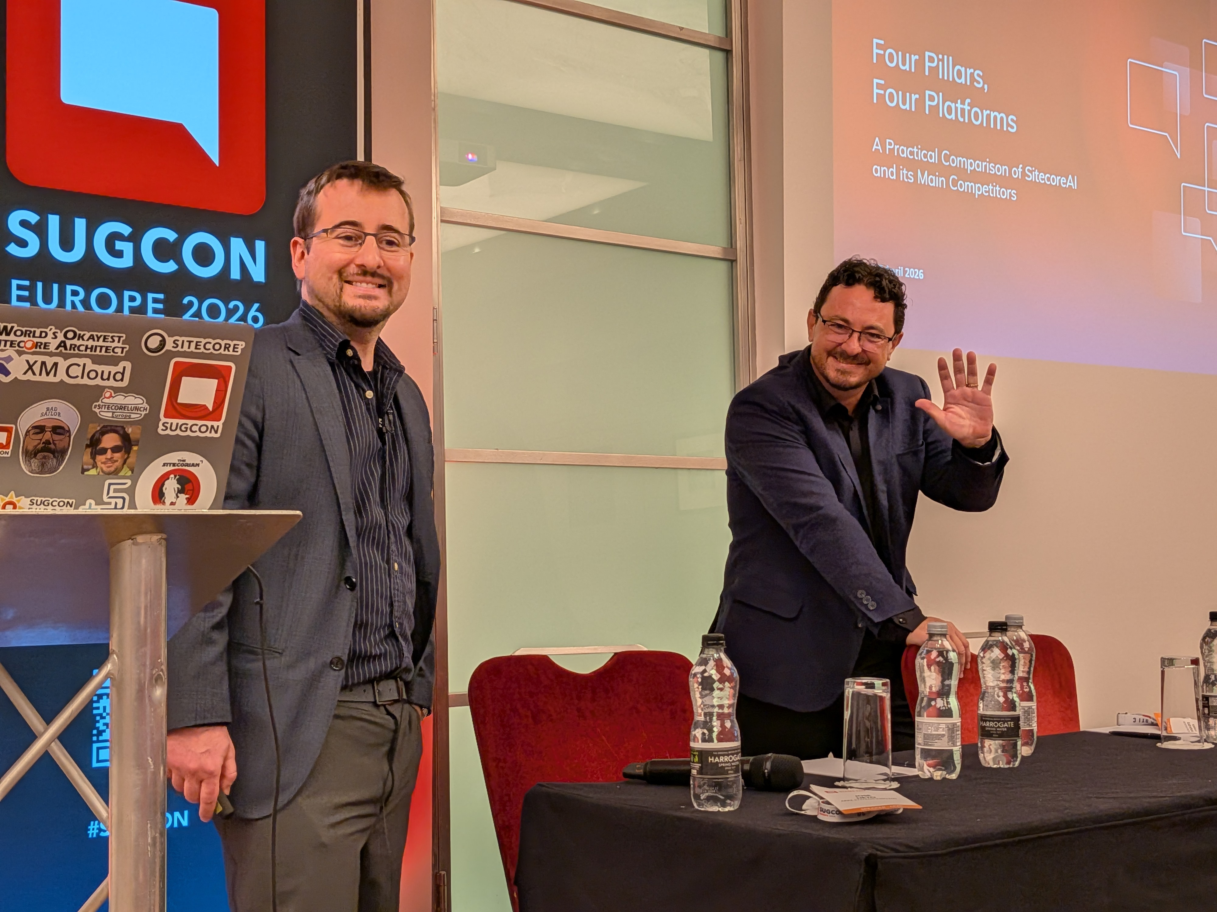
Sitecore AI vs. Competitors — Who, Why & How
Four Pillars, Four Platforms • Rodrigo Peplau & Jose Neto
Arke (acquired by MSQ) is a platform-agnostic consultancy with ~40 developers in Brazil. This analysis was driven by curiosity — not commissioned. Hands-on sandbox testing where available; public docs elsewhere.
Competitors Evaluated
Adobe Experience Manager (AEM)
Optimizely
Contentstack
Four-Pillar Framework
Pillar 1 — Customising the DXP → App Studio
Pillar 2 — Agentic Automation → Agentic Studio
Pillar 3 — Community Marketplace
Pillar 4 — Connectivity & Integration → Sitecore Connect

Slide 6
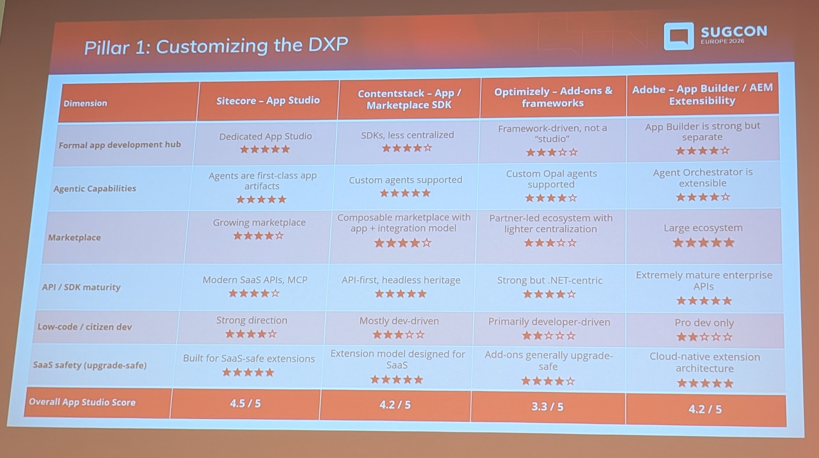
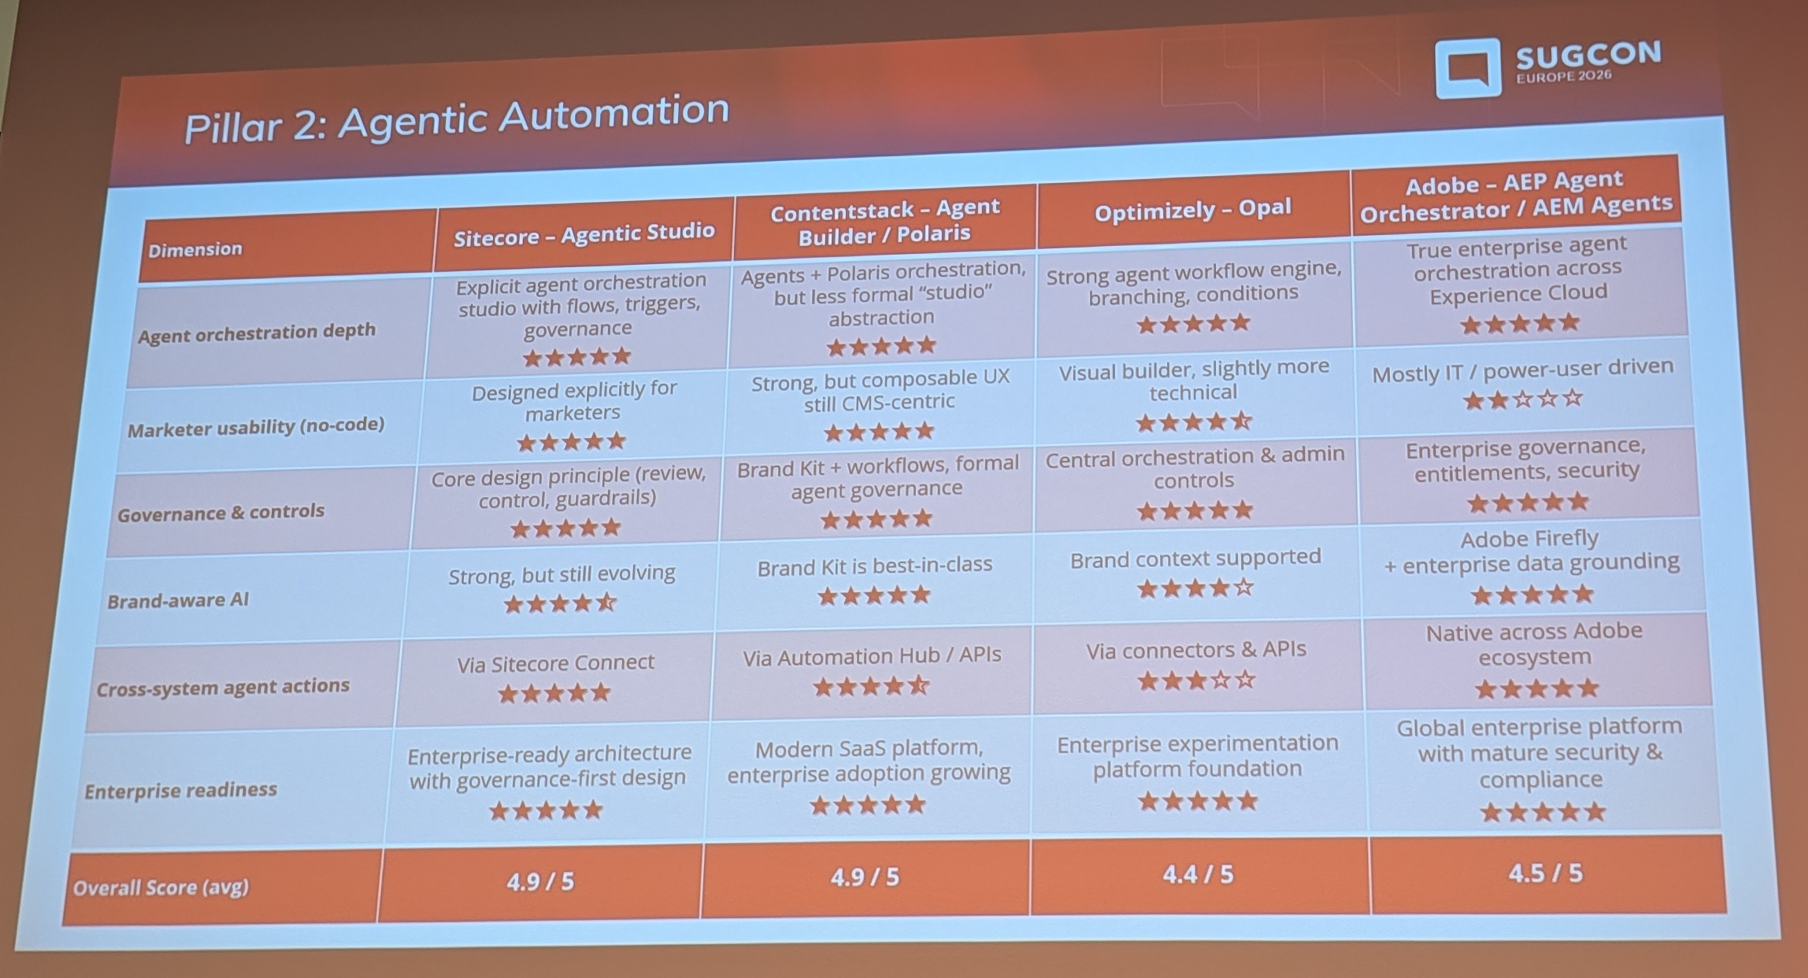
Pillar 1: App Studio & Pillar 2: Agentic Studio
Four Pillars, Four Platforms • Rodrigo Peplau & Jose Neto
PILLAR 1 — CUSTOMISING THE DXP
Legacy Sitecore (v8-10) meant deep platform code — modifying pipelines, overriding DLLs. Every upgrade was a reconciliation project. In SaaS, aggressive customisation gets punished.
App Studio provides a centralised hub to create, manage and delete custom apps. Apps run in isolation — platform updates cannot break customisations.
Score: Sitecore ~4.8★
Formal app dev hub: 5★ (vs 3-4★)
SaaS safety / isolation: 5★
Low-code capabilities: 4★ (vs 2-3★)
PILLAR 2 — AGENTIC AUTOMATION
~20 pre-built agents out of the box (blog writing, translation, research, AEO/GEO, account-based marketing). No-code agent configuration with visual prompts, schemas and workflow steps.
Human-in-the-loop approval workflows
Brand-aware agents with tone of voice
Configurable access control (private/shared/public)
Spaces for team collaboration on agents
Score: Sitecore tied or marginally ahead
Being newer means learning from competitors' mistakes. Very close across all four platforms.

Slide 7
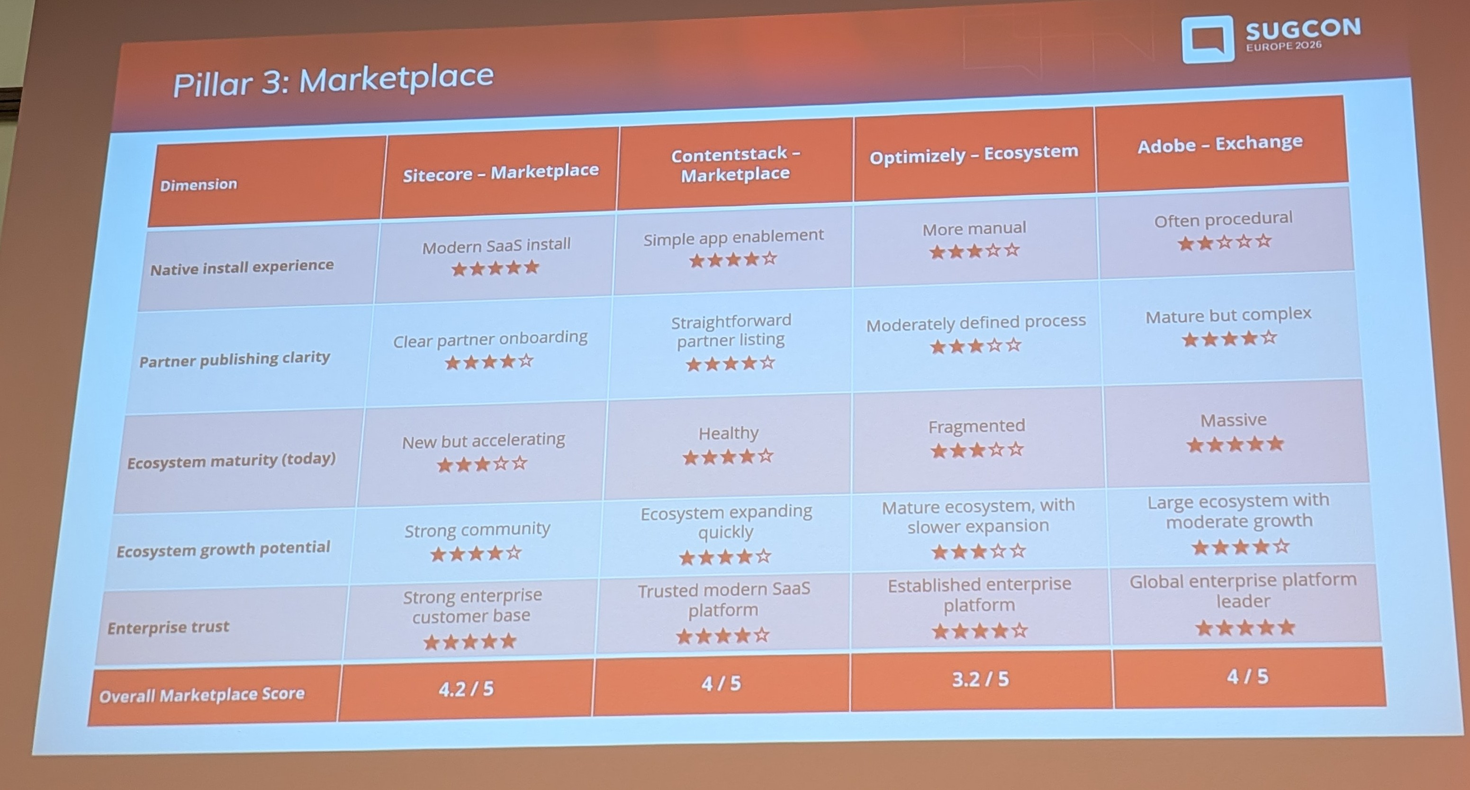
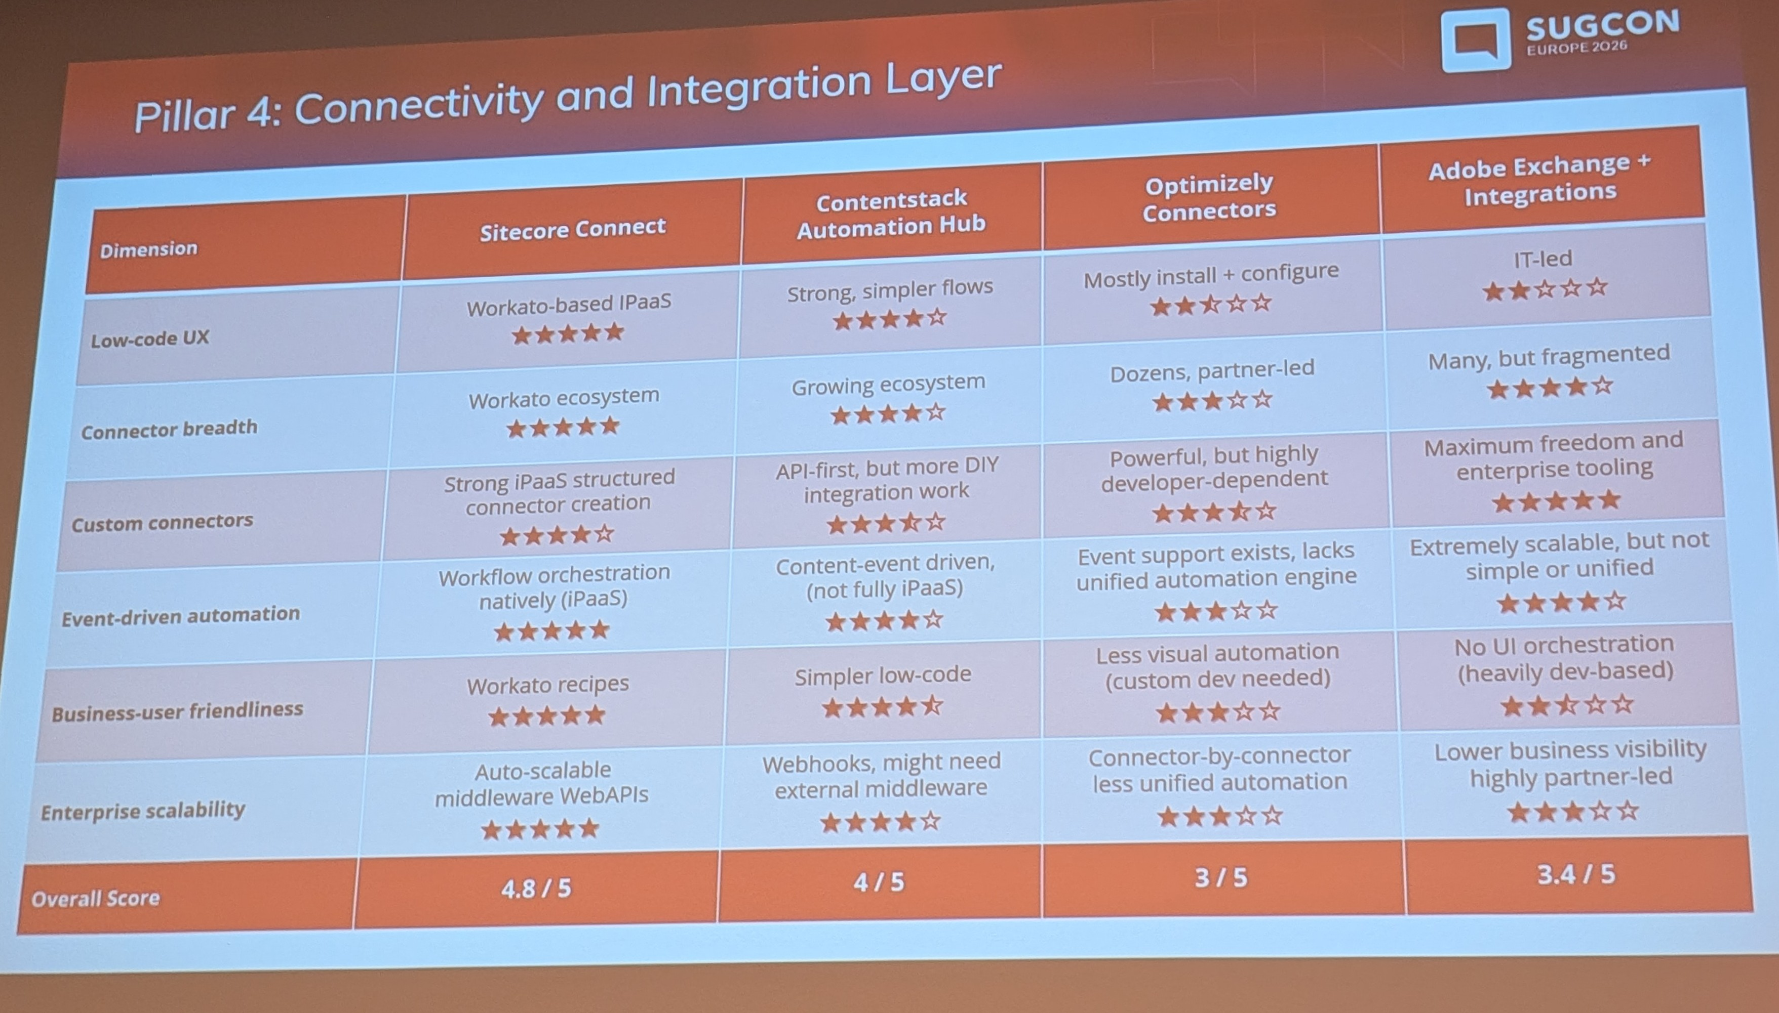
Pillar 3: Marketplace & Pillar 4: Sitecore Connect
Four Pillars, Four Platforms • Rodrigo Peplau & Jose Neto
PILLAR 3 — COMMUNITY MARKETPLACE
A centralised, curated hub — apps submitted, reviewed, versioned, rated, installed in one click. Monetisation now supported.
Google Analytics, Marketo, Power BI, Shopify connectors — all one-click install
Brand new (<60 apps) vs competitors' 50-100+ apps since 2017-2022
High growth potential: 10+ years of hackathons, 200+ MVPs, strong partner network
Score: ~4★ — best positioned for growth
PILLAR 4 — SITECORE CONNECT
Identified as Sitecore's biggest differentiator — the area where it leads competitors most clearly.
1,000+ pre-built connectors out of the box
Full no-code / low-code recipe builder
Visual Web API platform — no server management
Enterprise dashboards: usage, failures, concurrency, IP allowlisting
A true iPaaS (Integration Platform as a Service)
Score: Sitecore's strongest pillar by far

Slide 8
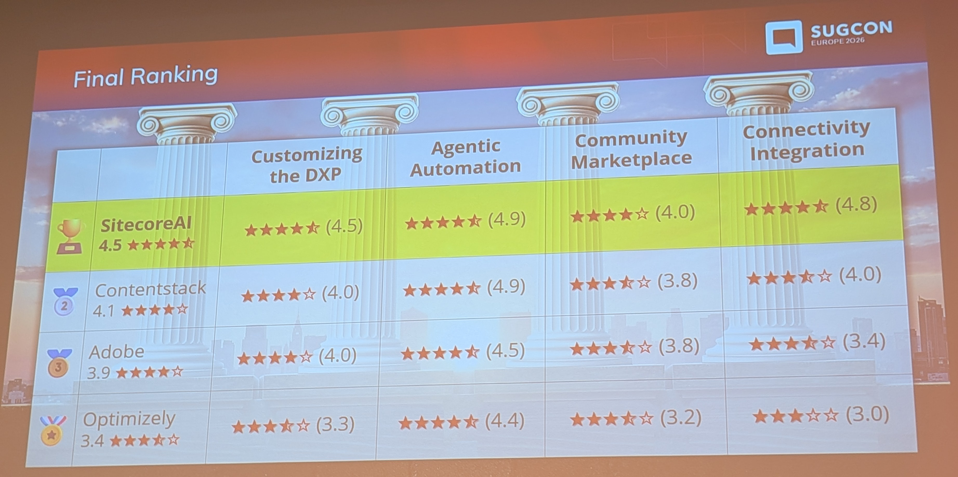
Final Scoreboard Summary
Four Pillars, Four Platforms • Rodrigo Peplau & Jose Neto
Pillar 1 — App Studio / Customisation: Sitecore ~4.8 ★
Pillar 2 — Agentic Studio: Very tight race / marginally leading
Pillar 3 — Marketplace: ~4.0 ★ (growth potential highest)
Pillar 4 — Sitecore Connect: Sitecore's clearest lead
Key Message
Sitecore AI has shifted from "complex enterprise-only" to a platform that can genuinely serve mid-market organisations. The four-pillar strategy delivers a strong balance of flexibility, governance, and time-to-value — but the landscape is moving fast. Treat this as a snapshot: revisit in 6 months.

Slide 9
Post-Quantum Cryptography — Why It Matters for Sitecore Developers (Right Now)
Harald Greve — Engineering Manager, Macmillan Cancer Support

Slide 10

The Threat: What Quantum Computing Breaks
Post-Quantum Cryptography • Harald Greve
Why It Matters
Quantum computers use qubits — superposition enables massive parallelism. 3 qubits = all 8 states at once. This makes quantum computers exceptionally fast at breaking the mathematics that underpins today's RSA encryption.
"Harvest Now, Decrypt Later" — Happening Today
Nation states and criminal groups are already intercepting and storing encrypted network traffic — in airports, hotels, on public Wi-Fi — with the intention of decrypting it later once quantum computing is ready.
Key Dates
2029 — Microsoft releases quantum-safe capabilities in Azure & M365
2029 — TLS certificate lifetime drops to 47 days (currently ~200 days)
Now — TLS 1.2 traffic being intercepted is already at risk from future decryption

Slide 11
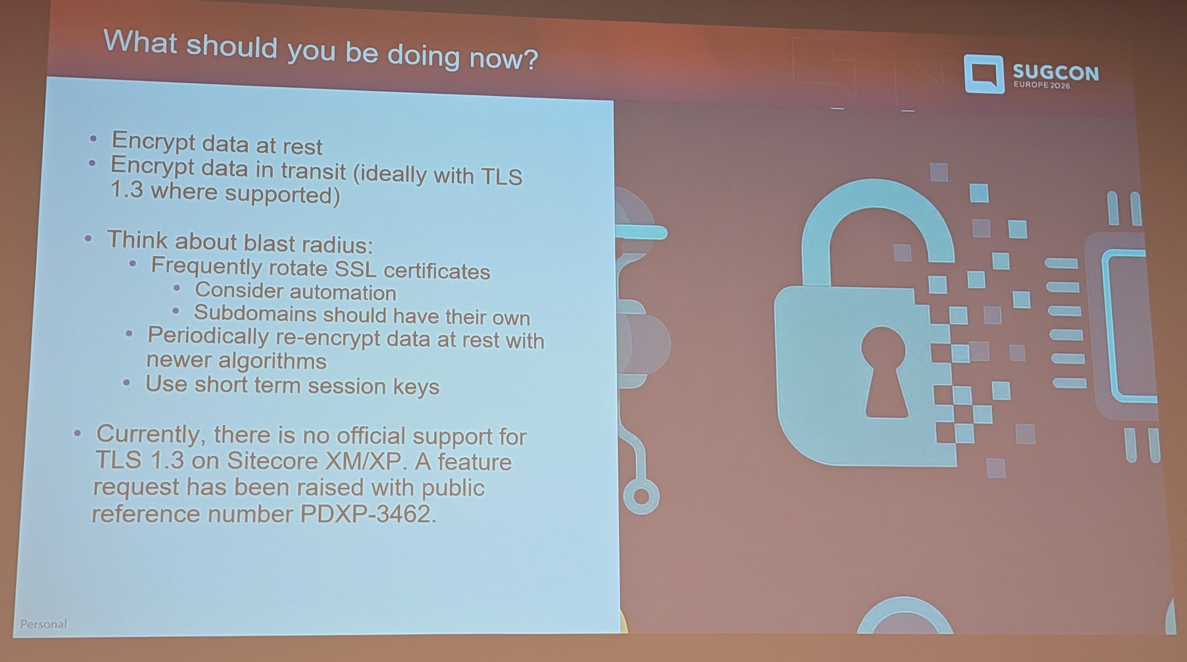
What To Do Now: Practical Steps for Sitecore Teams
Post-Quantum Cryptography • Harald Greve
#1 — Move to TLS 1.3 (Most Important Step)
TLS 1.3 prevents retrospective decryption — data captured cannot be decrypted later, even by quantum computers
Option A: Transition to Sitecore AI — Vercel handles TLS 1.3 automatically
Option B: Move to XM/XP 10.2+ headless with Next.js on Vercel (back-end still TLS 1.2)
Additional Actions
Encrypt data at rest using current best-practice algorithms
Automate certificate rotation (47-day lifetimes by 2029 — manual is not viable)
Use short-term session keys to limit blast radius
Re-encrypt existing stored data with updated algorithms proactively
Use SSL Labs to audit your current TLS configuration
Key Takeaway: Be proactive, not reactive. Data over TLS 1.2 is being harvested today. For teams migrating to Sitecore AI — TLS 1.3 at the edge is included by default.

Slide 12
The Sitecore AI Migration Middle State Nobody Talks About
Martin Miles — Sitecore Architect

Slide 13
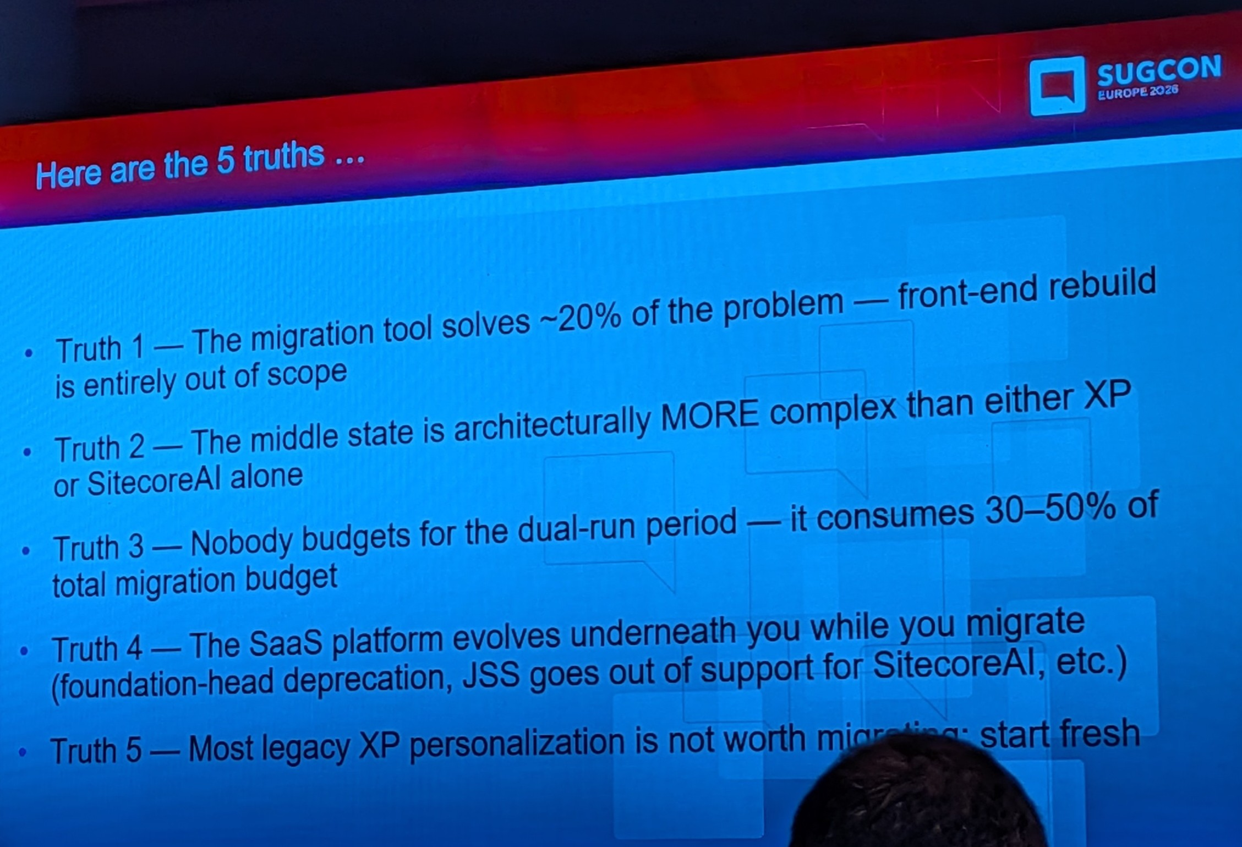
The Middle State: What It Is & Why It Hurts
The Sitecore AI Migration Middle State • Martin Miles
The Middle State is a dual-operation period where XP and Sitecore AI coexist simultaneously. It typically lasts 6 to 24 months and is where most migration pain actually occurs.
Five Truths Nobody Tells You
The middle state is more complex than either XP or Sitecore AI alone
Nobody budgets for it — real costs run 30–50% over original estimates
Content freezes become risky — short, sharp freezes (hours, not weeks) only
The SaaS platform keeps evolving while you migrate — the target moves
Personalization debt does not resolve itself
Should You Do a Hybrid Migration?
Full marketing utilisation or data sovereignty → clean migration may be forced
Large content (100+ items), budget & team available → hybrid is right
Heavy XP personalisation tied to XDB → proper refactoring needed first

Slide 14
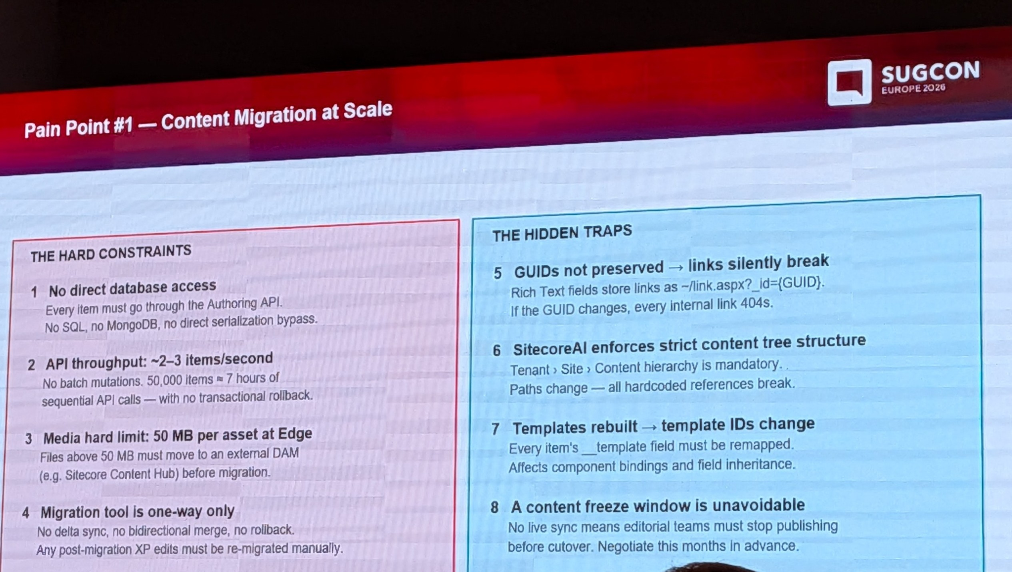
Four Major Friction Points in the Middle State
The Sitecore AI Migration Middle State • Martin Miles
1. Content Migration Limits
No direct DB access in SaaS — authoring API limited to ~2-3 req/sec
Media Library 50MB per published item limit
Some tools don't preserve GUIDs — breaks all rich text links
Workaround: run migration SQL against local Docker container
2. Routing Complexity
Use Azure Front Door (or equivalent) as single gateway
Split traffic: specific paths to new platform, remainder to legacy
3. Analytics Split-Brain
XDB and CDP have incompatible data models
Anonymous contacts, engagement values, historical reporting cannot be migrated
Marketing works across two dashboards simultaneously
Analytics gap is simply unavoidable — set expectations early
4. Personalization Drift
Use CDP engagement data collection from day one
Short middle state (≤6 months) with inconsistent personalisation is acceptable
Never replicate XP rules one-to-one into CDP — it's an anti-pattern

Slide 15
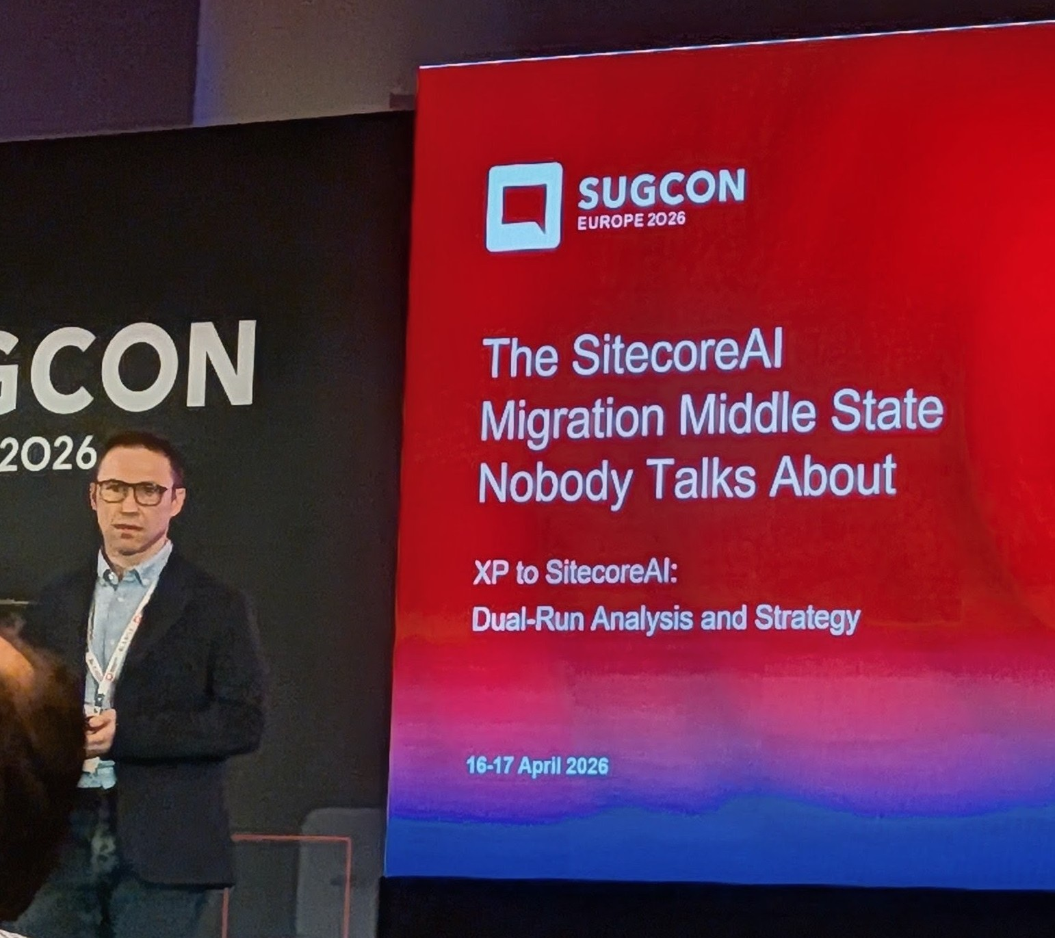
How to Navigate: Patterns, Signals & Decisions
The Sitecore AI Migration Middle State • Martin Miles
Section-by-Section Migration Pattern
Bulk content synchronisation — one large initial sync
Migrate low-risk independent sections first
Targeted content freezes per section (hours, not days)
Progress into complex sections (forms, navigation, auth areas)
Final cutover and decommission legacy XP
Critical Decisions
Search: Decide on day one — use external search provider for both XP and Sitecore AI
Auth: Use external IdP (Entra / Auth0) — never share JWT tokens between stacks
Monitoring: Traffic metrics, app telemetry, web vitals, content data integrity — all four levels
Key Takeaway: Design the middle state intentionally before you start. Plan for it as a first-class phase — not an awkward gap between two clean states.

Slide 16
Exploring Sitecore AI Publishing — How to Make Your Authors Love Publishing Again
Simon Hauck — Lead Sitecore Engineer, Merkle

Slide 17
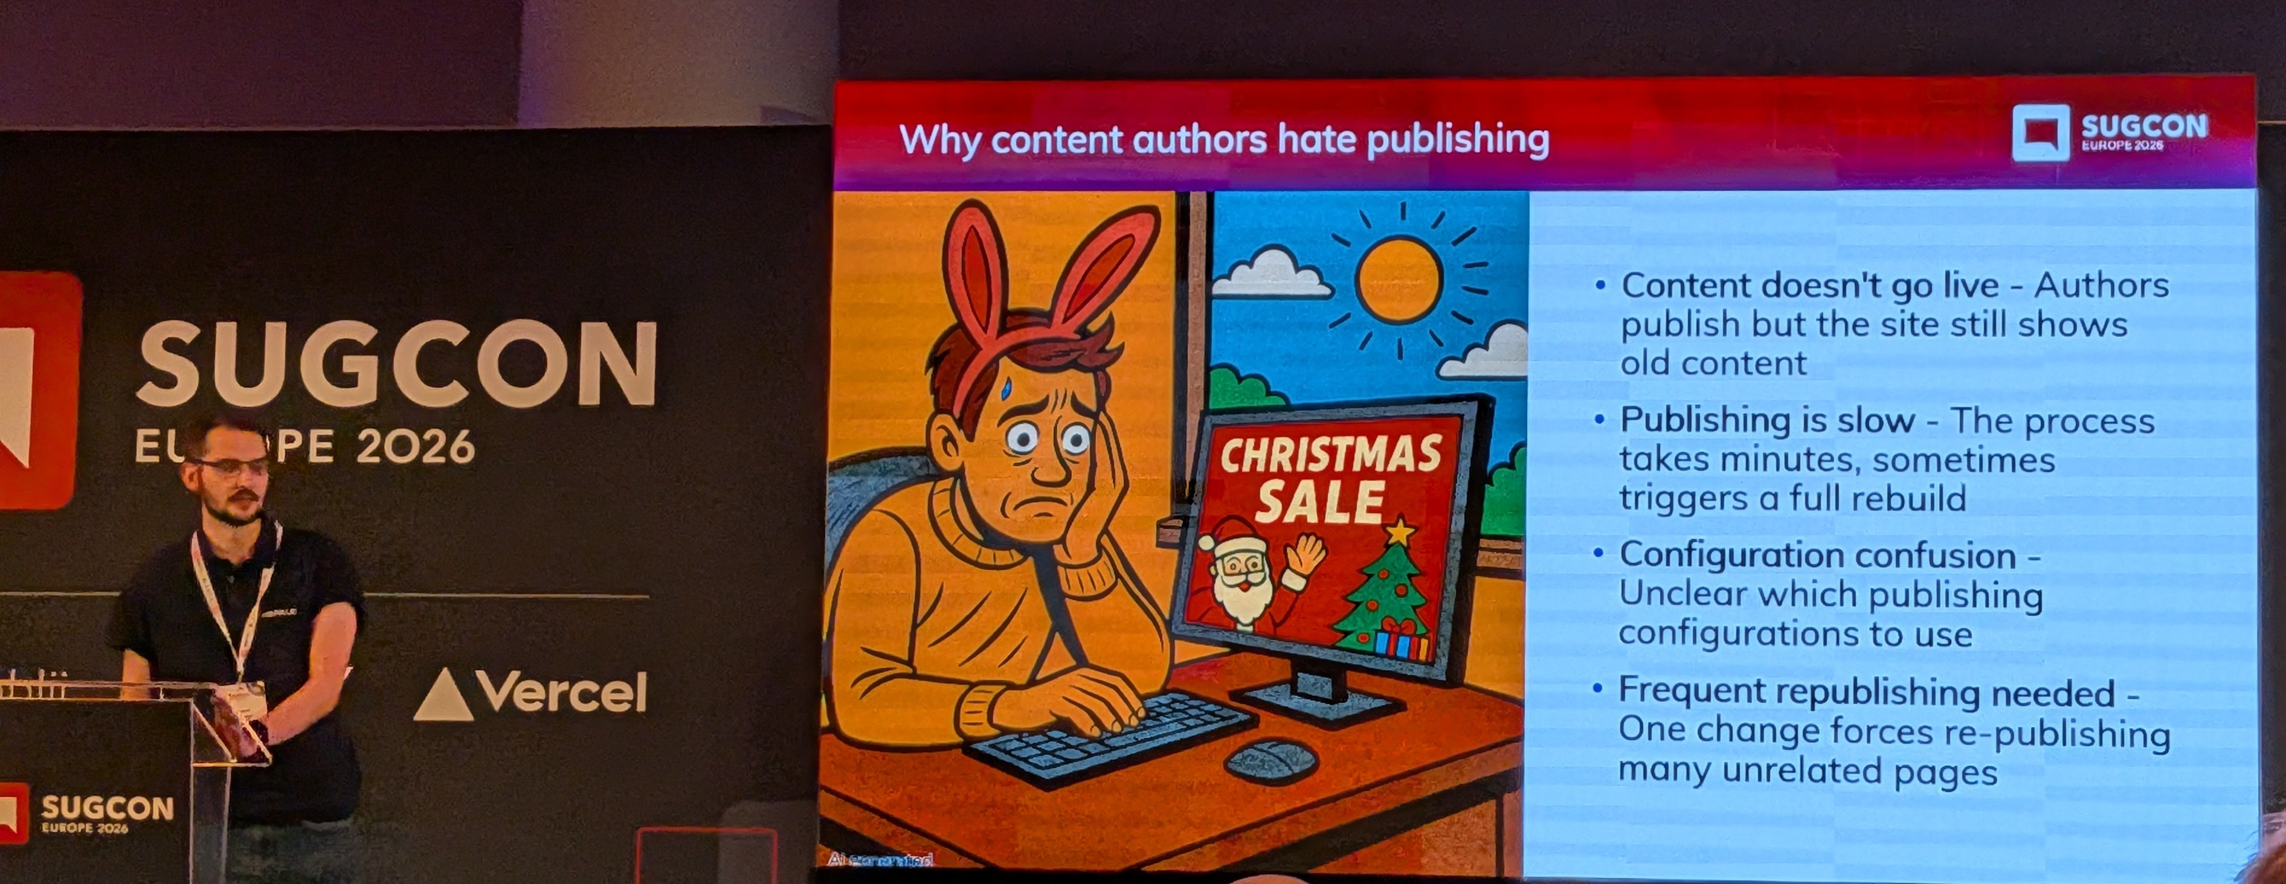
Why Authors Hate Publishing & Caching Strategies
Sitecore AI Publishing & Cache Validation • Simon Hauck
The Problem
Sitecore serves updated content correctly. The HEAD application (Next.js) is still serving cached content. Cache validation is a developer responsibility — it does not come out of the box.
Next.js Caching Layers That Matter
Data Cache — cross-request, stores Experience Edge content. Invalidated via tags
Full Route Cache — cached HTML per route, invalidated per URL path
Router Cache — client-side, cannot be controlled server-side. Leave it alone
Caching Strategies
SSG: Build-time only. Fast but content never updates without rebuild
ISR: Cached with periodic revalidation. Challenge is tuning the timing
SSR: Always fresh but expensive at scale — too many API calls
Recommended: ISR + on-demand revalidation via webhooks

Slide 18
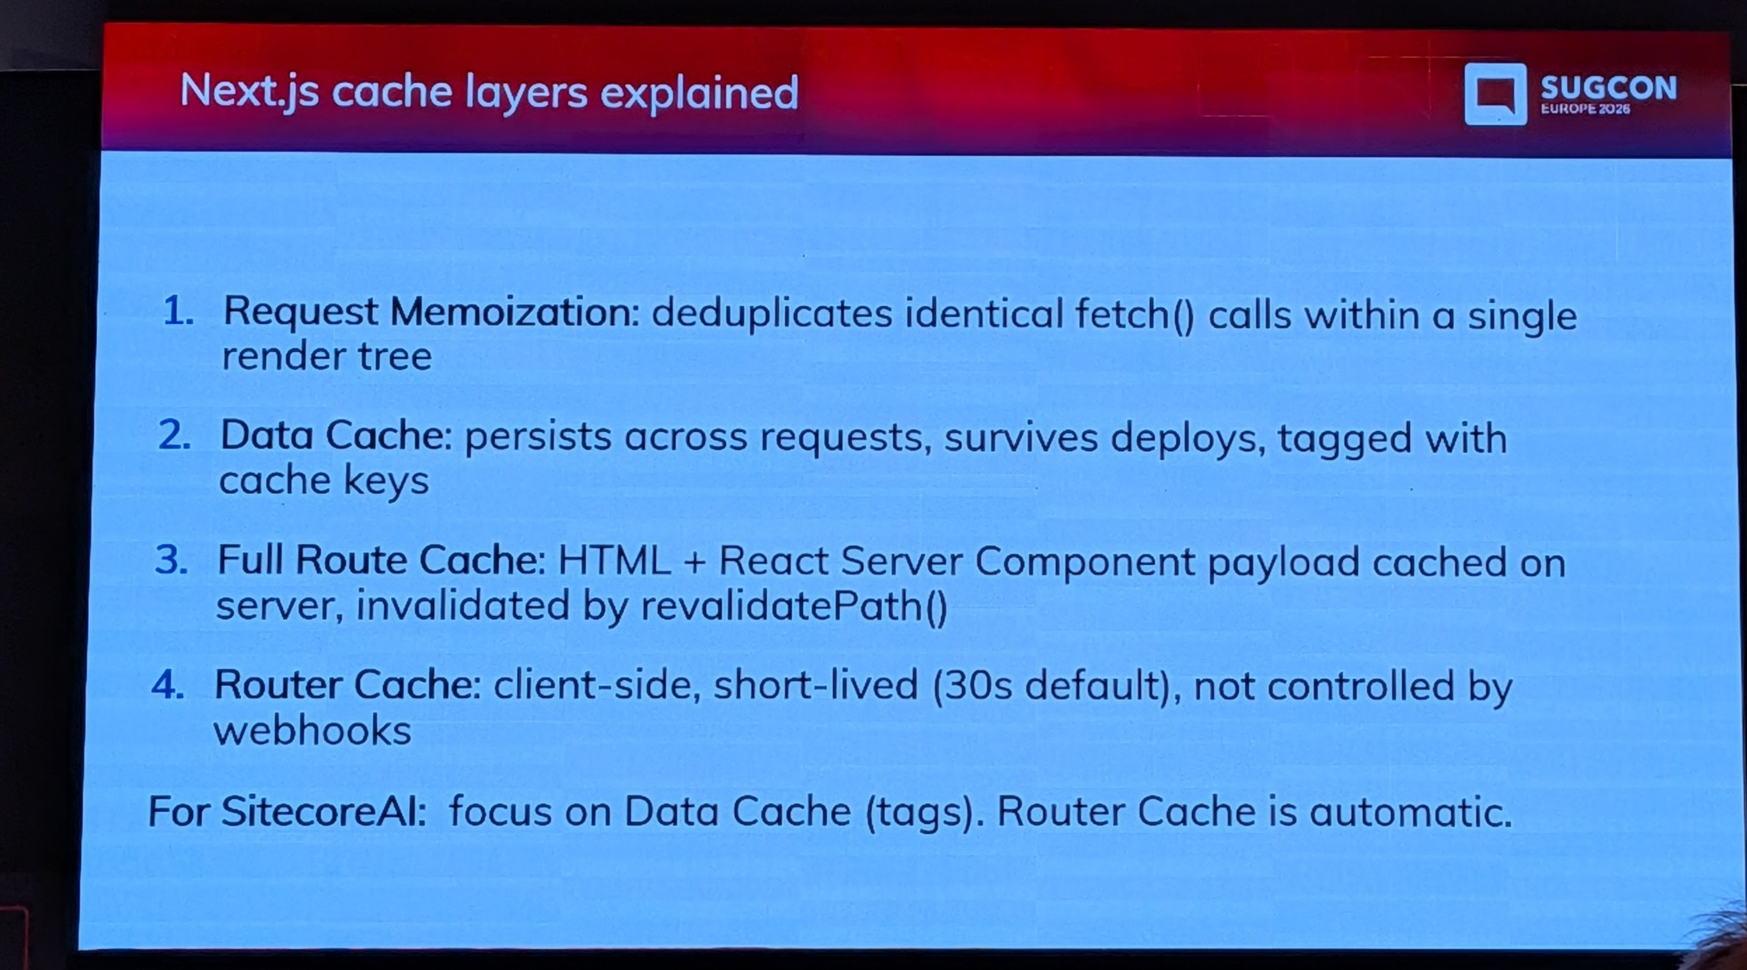
The Target Publishing Pipeline & Content Tagging
Sitecore AI Publishing & Cache Validation • Simon Hauck
Four-Step Pipeline for Immediate Content Updates
Author publishes in XM Cloud → content pushed to Experience Edge
Webhook fires — payload contains the item GUID. Always include a secret in the header
Head app receives webhook — extracts content IDs including layout suffix variants
revalidateTag() called for every linked cache tag — next request serves fresh content
Content Tagging by Component Type
Page-specific: IDs extracted from layout data automatically. Straightforward
Shared: Also in layout data as data sources. Tagged and revalidated automatically
Global (header/footer/nav): Tricky — not in layout data. Either restructure nav into layout data, or tag ALL pages with global component ID

Slide 19
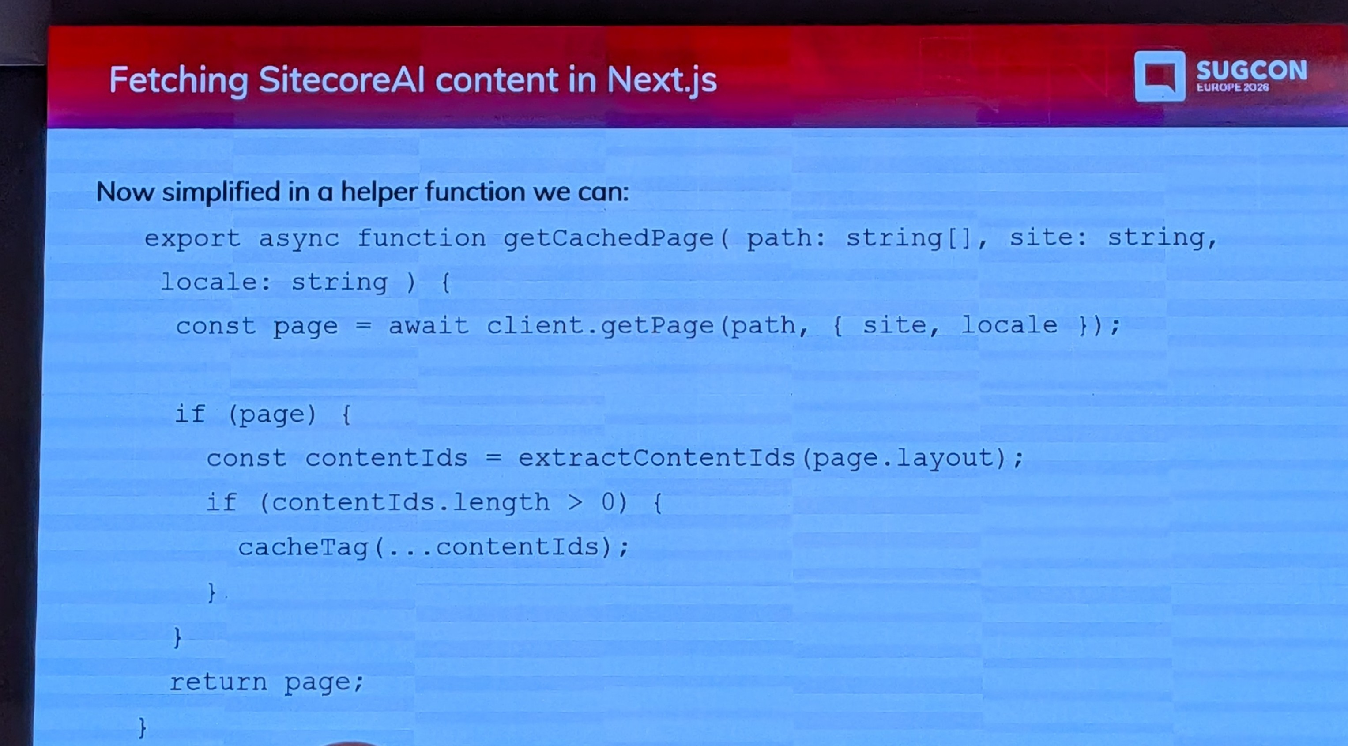
Pitfalls, Monitoring & Key Takeaways
Sitecore AI Publishing & Cache Validation • Simon Hauck
Common Pitfalls to Avoid
Unsecured webhook endpoint — anyone who discovers the URL can clear all caches
Using Preview API data instead of Published data — bypasses ISR entirely
Unmonitored webhooks — can silently stop working for months. Log all calls
Key Takeaways
Understand the pipeline boundary: everything after Experience Edge is your responsibility
Use ISR + webhooks together — webhooks for instant updates, ISR as safety net
Tag your content properly from the start with Sitecore item IDs
Global components need special handling — make them part of layout data if possible
Secure, monitor and log your webhooks — they are production-critical

Slide 20
MC-what-the-P is that? And how does it relate to Sitecore
Morten Ljungberg — Sales Engineer, Sitecore

Slide 21
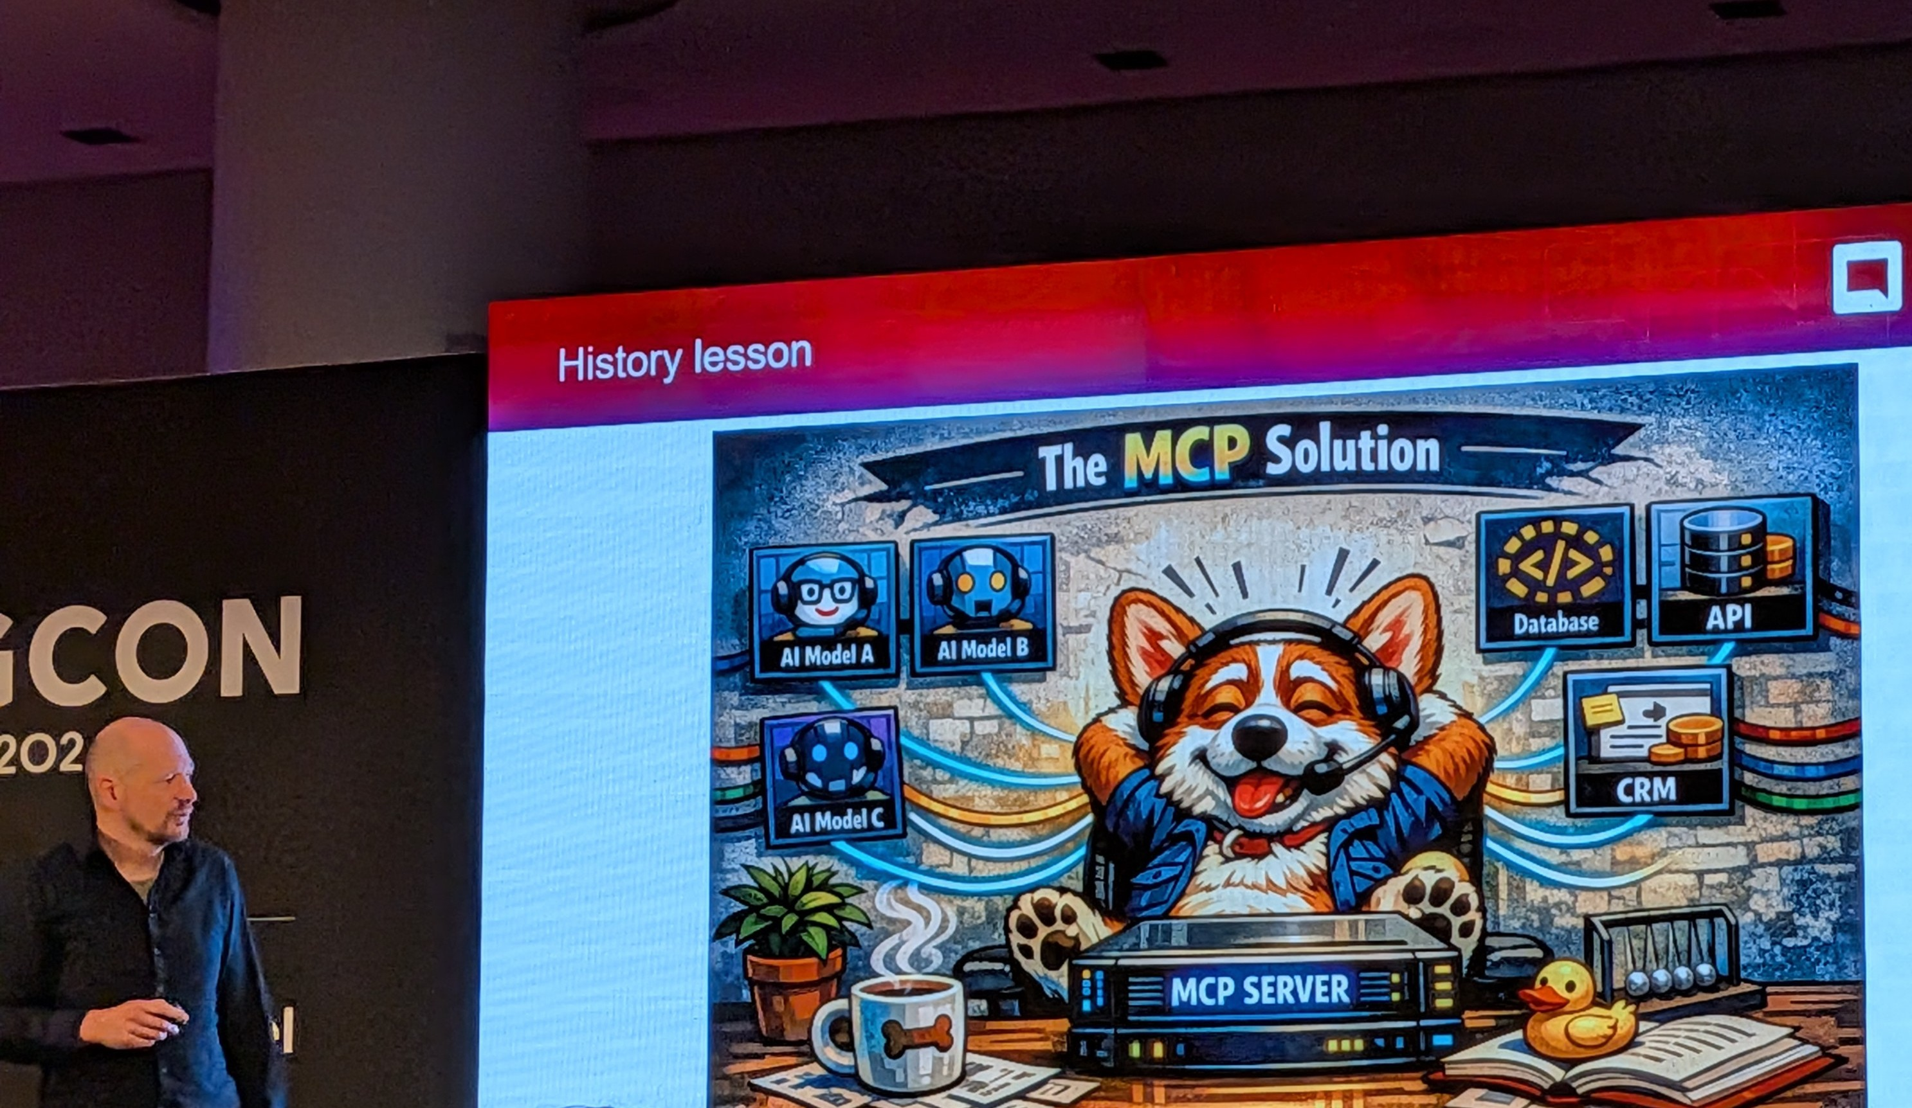
What Is MCP & How It Works
MC-what-the-P is that? • Morten Ljungberg
The M x N Problem
The Model Context Protocol (MCP) was introduced by Anthropic in November 2024. When M different AI tools need N different AI clients, each needing bespoke connections, complexity explodes. MCP solves this with a single open standard — think of it like USB for AI tools.
Architecture
MCP follows a client-server model:
MCP Host (e.g. Claude, Cursor, VS Code) connects to...
MCP Server which exposes:
  Tools — actions the AI can perform
  Resources — data the AI can read
  Prompts — pre-built instruction templates
MCP servers can run locally or remotely. Building one is straightforward — import the SDK, define tools/resources/prompts, and expose them.

Slide 22
Sitecore MCP Services & Live Demo
MC-what-the-P is that? • Morten Ljungberg
Three Publicly Available MCP Services
Marketer MCP — 42 tools that translate marketer intent into Sitecore actions. Create pages, manage assets, update content fields, query sites. OAuth via Google/GitHub
Documentation MCP — Single powerful search tool querying the entire Sitecore knowledge base. Returns precise answers and field-level examples. Highly recommended for daily use
Block MCP — Helps developers follow Sitecore style guide when building Marketplace apps. Installs components, adds buttons/cards/alerts into TSX files
Live Demo Highlights
Marketer MCP attached as a skill inside Sitecore's AI agent environment
Plain language: "List all sites" → MCP auto-selected the right tool from 42 available
Updated Title field and Basic Data field on homepage — no code, no CMS clicks
Returned direct preview URL to the updated item

Slide 23
MCP Roadmap: What's Coming
MC-what-the-P is that? • Morten Ljungberg
DAM MCP (In Progress — Most Requested)
Combine Market MCP + DAM MCP to work with assets across platforms
Enable image fields to be filled automatically when AI creates pages
AI can search for appropriate images in DAM during page creation
XM Cloud / XMHD MCP (Upcoming)
Based on next evolution of XM, built on .NET Core
Waiting on platform release to expose the right APIs
Development MCP (Upcoming)
Work entirely inside IDE without repetitive scaffolding
Create components, generate rendering definitions, hook up automatically
Key Takeaway: MCP is the standardisation layer that lets AI act directly inside Sitecore — for marketers, developers and beyond.

Slide 24
How ChatGPT, Gemini & Co. "see" your Sitecore site
Mark Lowe — Sitecore Architect

Slide 25
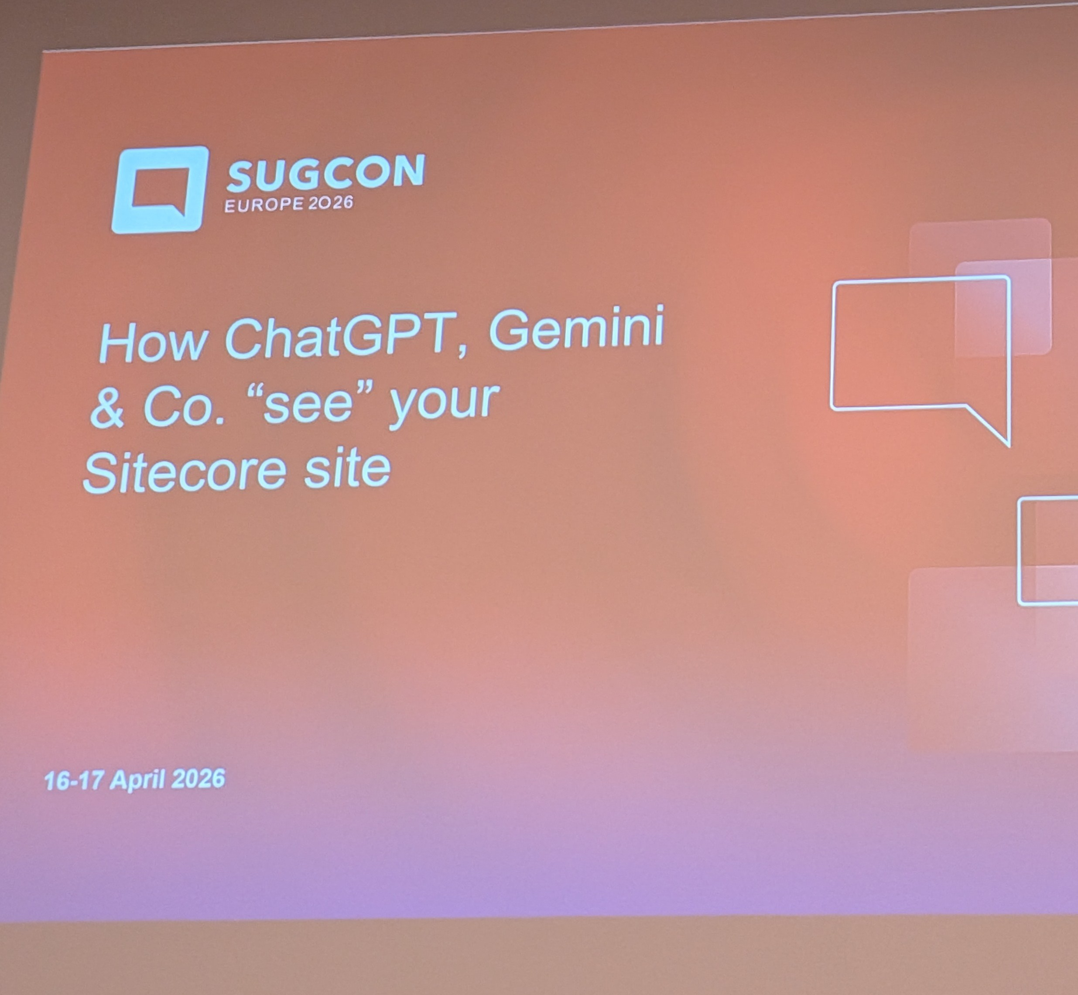
How AI Engines Crawl Your Sitecore Site
How ChatGPT, Gemini & Co. “see” your Sitecore site • Mark Lowe
AI chat systems like ChatGPT, Gemini, and Perplexity are becoming a primary way users discover information. Unlike traditional search engines, they crawl, parse, and reason over web content in fundamentally different ways.
Key Differences from Google
No JavaScript execution — AI crawlers fetch raw HTML only. If content is JS-rendered and returns a blank shell, the AI sees nothing
TTFB matters most — Time to First Byte, not Lighthouse paint scores. SSG/ISR helps significantly
PDFs are largely ignored — publish important content as web content with at least a summary
Videos are a black box — AI engines do not analyse video. Add transcripts or written summaries
Content Best Practices (GEO / AEO)
Structure content in clear Q&A format — AI engines favour directly answerable content
Use proper heading hierarchy (H1 → H2 → H3) and descriptive image alt text
Write content that reads well as plain text / Markdown
Be trustworthy: clinical sign-off, named authors, cited sources, expert review

Slide 26
Technical Controls: What You Can Do Right Now
How ChatGPT, Gemini & Co. “see” your Sitecore site • Mark Lowe
robots.txt — still the primary control. Specify what crawlers can use for training vs. real-time retrieval. Checked daily by OpenAI, Google, and others
Sitemap — must be clean and functional. Broken sitemaps (404s, test content) undermine crawling
llms.txt — proposed standard (not yet widely adopted). Tells AI engines what content is most important. Claude Code reads it for technical docs — worth watching
JSON-LD / Schema.org — likely helps with trustworthiness signals, especially for content with dates, offers, or author information
Bing Webmaster Tools — often overlooked. OpenAI has historically used Bing's index, so ranking in Bing can influence AI visibility
Recommended tool: Rank Ready by Conejos (free, rankready.io) — analyses Lighthouse scores, Q&A structure, and image alt text

Slide 27
Key Takeaways for Sitecore Teams
How ChatGPT, Gemini & Co. “see” your Sitecore site • Mark Lowe
Test with JavaScript disabled (Chrome DevTools or Google Search Console). Content must be present in raw HTML
Prioritise Time to First Byte — static site generation with Sitecore headless (Next.js) is a strong advantage
Audit your robots.txt — make deliberate decisions about what AI crawlers can and cannot access
Write for humans, structure for machines — clear headings, Q&A format, alt text, and transcripts help both users and AI
Avoid content behind PDFs or JavaScript — publish important content as accessible, crawlable web pages
Monitor llms.txt adoption — not yet essential, but worth watching for technical documentation sites

Slide 28
Sitecore CDP & Personalize

Slide 29

Speaker
Stefan Zhuntovski
Sitecore developer
americaneagle.com

Slide 30
Agenda
Sitecore CDP & Personalize • Yonko & Nona
Sitecore CDP — What it is, how it works, and why it matters
Sitecore Personalize — Real-time personalized experiences built on CDP data
Integration — How CDP and Personalize complement each other
Business Value — Real-world use cases and ROI

Slide 31
Sitecore CDP
Customer Data Platform

Slide 32
What is Sitecore CDP?
Sitecore CDP & Personalize • Yonko & Nona
CDP stands for Customer Data Platform — a centralized system that collects and unifies customer data from multiple sources.
Core Capabilities
Collects data from websites, mobile apps, CRM, email tools, and offline systems
Creates a single customer view — a unified profile for each individual user
Captures behavior in real time as users interact with digital touchpoints
Enables businesses to react to customer behavior as it happens, not after the fact
Web
Social
Mobile
CDP
Offline
CRM
Email

Slide 33
Key Features of Sitecore CDP
Sitecore CDP & Personalize • Yonko & Nona
Real-Time Data Collection — Tracks page views, clicks, searches, and purchases as they happen
Identity Resolution — Connects interactions across devices to the same user (e.g., mobile visit + desktop login)
Unified Customer Profile — Combines behavioral, transactional, and demographic data into one comprehensive view
Segmentation — Groups users by behavior patterns, interests, or likelihood to convert
Predictive Analytics — Uses machine learning to anticipate churn, purchase likelihood, and future behavior
1
Real-Time
Collection
2
Identity
Resolution
3
Unified
Profile
4
Segmentation
5
Predictive
Analytics

Slide 34
Why Sitecore CDP Matters
Sitecore CDP & Personalize • Yonko & Nona
The Problem
Customer data is fragmented across separate systems that don’t communicate
Leads to incomplete or inconsistent views of customers
How CDP Solves It
Eliminates data silos — centralizes information into one place
Deeper customer understanding — who they are, how they behave, what they need
Real-time responsiveness — act immediately instead of analyzing after the fact
Foundation for personalization — without unified data, meaningful personalization isn’t possible
BEFORE
CRM
Web
Email
Mobile
AFTER
Unified
Customer View
Personalize
Segment
Analyze

Slide 35
Sitecore Personalize
Real-Time Decisioning Engine

Slide 36
What is Sitecore Personalize?
Sitecore CDP & Personalize • Yonko & Nona
If CDP is about collecting and organizing data, Personalize is about using that data to take action.
How It Works
A real-time decisioning engine that determines what experience each user should see
Delivers personalized content, product recommendations, offers, and messaging
Evaluates user behavior, preferences, and context in real time
Personalization is not static — it adapts dynamically as the user interacts
User
Data
Decision
Engine
Personalized
Experience
Behavior, context,
preferences
Real-time rules
& ML models
Content, offers,
messaging

Slide 37
Key Features of Sitecore Personalize
Sitecore CDP & Personalize • Yonko & Nona
Real-Time Decisioning — Continuously evaluates user behavior and adjusts the experience accordingly
Experimentation — Run A/B tests and multivariate tests to compare content versions and determine what performs better
AI-Driven Recommendations — Algorithms suggest products or content based on user behavior patterns
Omnichannel Delivery — Personalization across websites, mobile apps, email campaigns, and other digital touchpoints
1
Real-Time
Decisioning
2
A/B
Testing
3
AI-Driven
Insights
4
Omnichannel
Delivery

Slide 38
Use Cases for Personalization
Sitecore CDP & Personalize • Yonko & Nona
Product Recommendations — Suggest relevant products based on browsing and purchase history
Personalized Homepage Content — Different banners, promotions, and messaging per user based on interests and behavior
Cart Abandonment Recovery — Trigger reminders or incentives when users leave without completing a purchase
Targeted Promotions — Offer specific discounts or deals to selected audiences, increasing conversion likelihood
Product Recommendations
Personalized Homepage
Cart Abandonment Recovery
Targeted Promotions

Slide 39
Integration
CDP + Personalize Working Together

Slide 40
CDP + Personalize Integration
Sitecore CDP & Personalize • Yonko & Nona
Think of CDP as the data layer and Personalize as the execution layer.
Three-Step Process
Step 1: Collect — Data is gathered from various sources and unified in CDP
Step 2: Profile — A customer profile is created and continuously updated
Step 3: Personalize — Personalize uses the profile to trigger relevant experiences in real time
This integration enables truly data-driven personalization.
Step 1: COLLECT
CDP Data Layer
Step 2: PROFILE
Unified Customer Profile
Step 3: PERSONALIZE
Execution Layer

Slide 41
Real-Time Customer Journey Example
Sitecore CDP & Personalize • Yonko & Nona
First Visit
User visits the website — CDP starts tracking pages viewed and products browsed
Behavior is added to the user profile in real time
Personalize Activates
Shows related products, highlights specific promotions, or adjusts content layout
Decisions based on live behavioral signals, not static rules
Return Visit
The system remembers previous interactions and continues personalizing
Over time, the experience becomes more relevant — a smoother, more engaging journey
1
2
3
First Visit
Personalize Activates
Return Visit
CDP tracks pages, products and behavior
Real-time content, offers and decisions
Remembered prefs, continuous learning

Slide 42
Business Value
Benefits & ROI

Slide 43
Benefits & ROI
Sitecore CDP & Personalize • Yonko & Nona
Increased Conversion Rates — Users see relevant content and offers, making them more likely to take action
Improved Customer Engagement — Personalized experiences capture attention and encourage interaction
Higher Customer Retention — Users who feel understood and valued are more likely to return
Faster Optimization — Built-in testing and analytics enable continuous improvement based on real data
Overall: better business performance and a stronger competitive position.

Slide 44
Summary & Q&A
Sitecore CDP & Personalize • Yonko & Nona
Key Takeaways
Sitecore CDP provides a unified, real-time view of customer data
Sitecore Personalize uses that data to deliver tailored, dynamic experiences
Together, they enable meaningful, data-driven customer interactions at scale
Thank you! Questions?

Slide 45
Thank You
SUGCON Europe 2026
London — April 2026

